Slide 1
포켓몬 배틀 게임
2016. 10. 07
윤수환

Slide 2
Purpose
포켓몬을 이용한 턴제 배틀게임을 만든다.

Slide 3
System Requirements
전략패턴 사용
포켓몬 생성시 팩토리패턴사용

Slide 4
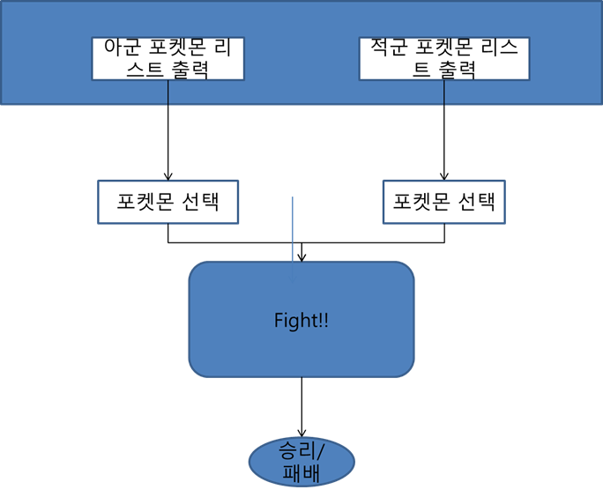
System Architecture
Explain overall modules of your system

Slide 5
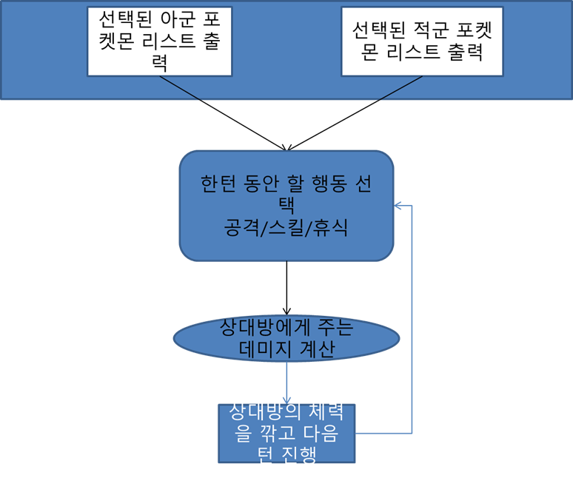
Processing Diagram
Explain how the modules work

Slide 6
Major Modules and Functions
Explain major modules, functions, and structures among whole modules in detail
팩토리패턴으로 인한 PokemonFactory class
전략패턴을 위한 TurnBehavior class와 SkillBehavior class, RestBehavior class, AttackBehavior class

Slide 7
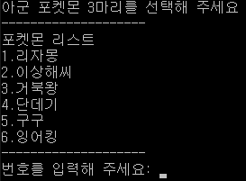
Interface Design
Show interface of your system
1.시작시

Slide 8
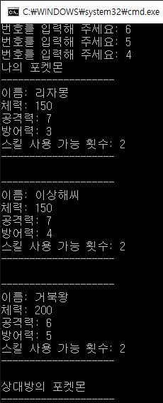
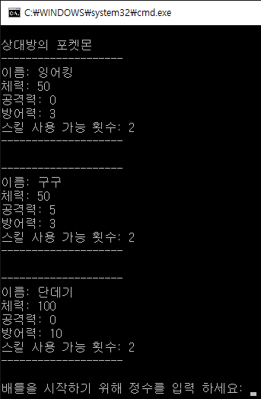
Interface Design
2.캐릭터 선택후

Slide 9

Interface Design
배틀시작

Slide 10
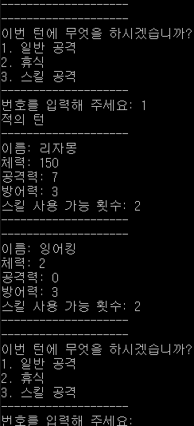

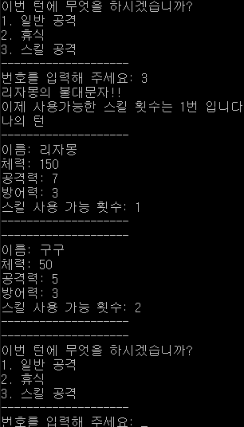
Interface Design
4. 각 스킬 공격시

Slide 11

Interface Design
마지막

Slide 12
Simulation
Make a plan that can show system requirements and additional functions before presentation so that we save time !!

